Slide 1
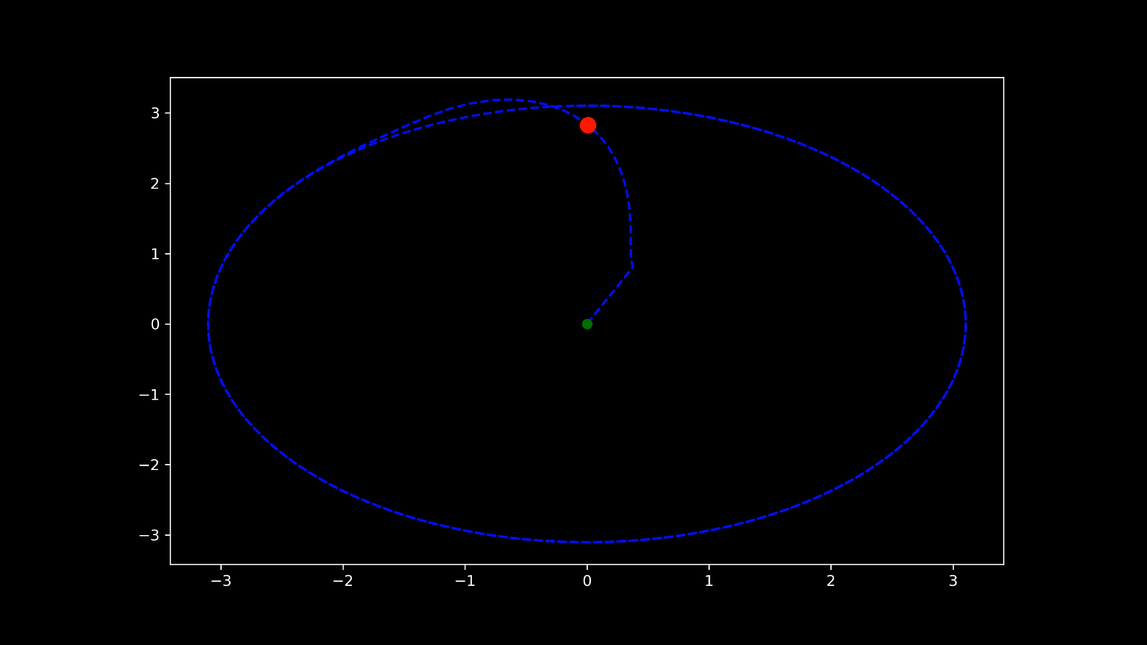
Vector Field Trajectory Tracking Control
Spring 2021 CSE 498 – Adv. Aerial Robotics
Final Presentation
Ruth Densamo

Slide 2
Why Use Vector Fields for Trajectory Tracking ?
Many control and planning techniques give an output in the form of a vector field along which the robot is intended to follow to accomplish the desired task
Examples : Navigation, Obstacle Avoidance, Collision Avoidance, Swarming and Flocking, Mobile Network connective maintenance controls
Ideal for robots in which dynamics do not play a major role because it is a challenge to control a robot along an arbitrary vector field especially if they have high dimensional nonlinear dynamics
Examples : Ground robots w/ gear reduction, slow moving aerial robots
Exception: Vehicles with the differential flatness property
Notes:
Can have artificial potential fields
http://www.cpdee.ufmg.br/~gpereira/papers/tro2010.pdf
that is the integration of path
planning, trajectory planning, and robot control in the same
approach, which allows for stability proofs and real-world im-
plementations [1]
Can guarantee collision avoidance by producing a dynamic vector field
Benefits : The vector ﬁeld is dynamic in the sense that it changes
according to the robots’ relative positions. This is necessary
to guarantee collision avoidance. Ceccarelli et al.

Slide 3
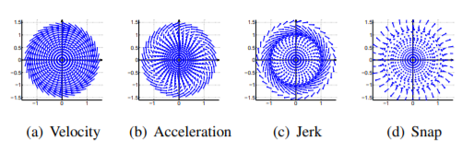

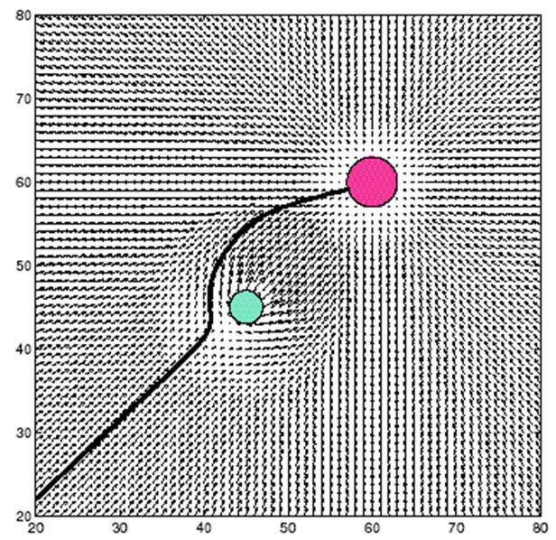
Vector Fields vs. Potential Fields
Vector Fields are like Potential Fields however, Vector Field (left) simply indicates a desired direction and is different from potential field because it does not represent the gradient of a potential field
Vector fields are general enough for any trajectory
The potential field P(x) is defined over the environment.
Sensor information y is used to estimate the potential field gradient
The motor vector u is determined to follow that gradient.
Notes:
The method is applicable to 1D, 2D, or 3D vector fields, but we show examples only with 2D vector fields for clarity. For example, consider a velocity vector field given by the equation V (x1, x2) = x2 −x1 −0.5 sin(x 2 1 +x 2 2 −1) x1 x2 , (12) in which all trajectories converge to the limit cycle x 2 1+x 2 2 = 1. Fig. 3 shows the velocity field (12) and its three time derivatives. −1 0 1 −1.5 −1 −0.5 0 0.5 1 1.5 (a) Velocity −1 0 1 −1.5 −1 −0.5 0 0.5 1 1.5 (b) Acceleration −1 0 1 −1.5 −1 −0.5 0 0.5 1 1.5 (c) Jerk −1 0 1 −1.5 −1 −0.5 0 0.5 1 1.5 (d) Snap Fig. 3. Vector field as in (12), with scaled vector length for plotting

Slide 4
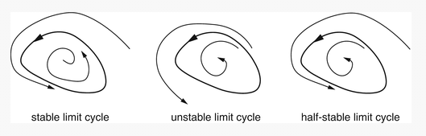
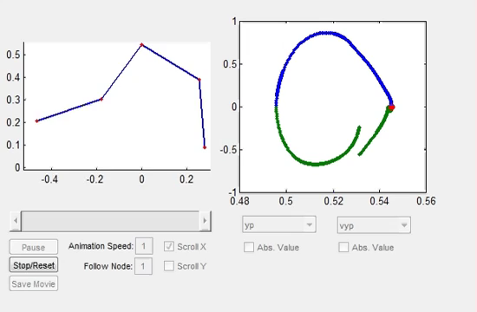
Limit Cycle
“A limit cycle is a isolated closed trajectory in phase space having the property that at least one other trajectory spirals into it either as time approaches infinity or as time approaches negative infinity.” – Science Direct
Phase space allows us to represent all possible states of a system as a measurement of its position and momentum (in mechanical systems) where each possible state corresponds to one unique point in the phase space. Makes it convenient to represent the state of oscillators and more clearly represent certain qualities of the system
An oscillation occurring only in non-linear systems with constant amplitude and frequency despite initial conditions
SpringerLink
https://www.youtube.com/watch?v=T0-zFIPWONU
Notes:
In linear systems limit cycles are not possible because the amplitude of the oscillations is determined by initial conditions unlike nonlinear systems
Types of Limit Cycle :
1. Stable / Attracting Limit Cycle – A stable cycle is one which attracts all neighboring trajectories
- Exhibit self-sustaining oscillations which means they oscillate in absence of external periodic forces e.g. beating of heart and other biological processes
2. Unstable Limit Cycle – If the neighboring trajectories are repelled from the limit cycle as time approaches infinity, then it is an unstable limit cycle
3. Half – stable limit cycles – Half stable limit cycles are one which attract trajectories from inside & repel those on the outside or vice versa
Phase space allows us to represent all possible states of a system as a measurement of its position and momentum (in mechanical systems) where each possible state corresponds to one unique point in the phase space. Makes it convenient to represent the state of oscillators
In dynamical system theory, a phase space is a space in which all possible states of a system are represented, with each possible state corresponding to one unique point in the phase space. For mechanical systems, the phase space usually consists of all possible values of position and momentum variables.
https://www.youtube.com/watch?v=0U3J_Ug075k
Amplitude depends on energy of the system and the size of the loop represents the energy of the system l
As a whole, the phase diagram represents all that the system can be, and its shape can easily elucidate qualities of the system that might not be obvious otherwise.
- Oscillations have constant amplitude and frequency regardless of initial conditions
Limit Cycle Nonlinear Control Systems
https://www.sciencedirect.com/topics/engineering/limit-cycle
https://link.springer.com/referenceworkentry/10.1007%2F978-1-4419-9863-7_533
In dynamical system theory, a phase space is a space in which all possible states of a system are represented, with each possible state corresponding to one unique point in the phase space. For mechanical systems, the phase space usually consists of all possible values of position and momentum variables.

Slide 5
I. VF Function for Limit Cycle
From a paper where they compute several different artificial vector fields for various tasks (Goncalves et al 2010, Vector Fields for Robot Navigation Along Time-Varying Curves in n-Dimensions)
Composed of an attractive term and circulating term:
Attractive term attracts the robot to the target curve
Circulating term make the robot traverse the curve.
Function outputs velocity magnitude and velocity angle
Acting more like a potential field because it uses the gradient of the potential function from center of the ring
Notes:
In addition to the ﬁeld that attracts the robot to the target
curve, another vector ﬁeld is also necessary to make the robot
traverse the curve. The computation of these ﬁelds and a method
to compose them, allowing for proofs of convergence, are the
main challenges to obtain good solutions. The composition of
an attractive and a rotational ﬁeld usually creates a stable limit
cycle in the robot conﬁguration space.
This paper presents a methodology for computation of artiﬁcial vector ﬁelds that allows a robot to converge to and circulate around generic curves speciﬁed in n-dimensional spaces. These vector ﬁelds may be directly applied to solve several robot-navigation problems such as border monitoring, surveillance, tar-get tracking, and multirobot pattern generation, with special application to ﬁxed-wing aerial robots, which must keep a positive forward velocity and cannot converge to a single point.
the approach is based on fully continuous vector ﬁelds and is generalized to time-varying curves deﬁned in n-dimensional spaces.
that is the integration of path
planning, trajectory planning, and robot control in the same
approach, which allows for stability proofs and real-world im-
plementations [1]. Given an n-dimensional domain Ω, a vector
ﬁeld h is deﬁned such that h :Ω → Tq(Ω), where Tq(Ω) is the
tangent space of Ω, and q ∈ Ω. In robotics, the domain Ω is the
robot’s conﬁguration space, also represented by C. The desired
task is then accomplished by forcing the robot to use the vector
ﬁeld as velocity or acceleration input.
http://www.cpdee.ufmg.br/~gpereira/papers/tro2010.pdf
This paper has presented a new methodology for robot navi-
gation along a closed, generic-shaped curve using a continuous
vector ﬁeld. The ﬁeld is given by the sum of three terms: 1)
the gradient of a potential function; 2) a circulation term; and
3) a correction term (in the case of time-varying curves).

Slide 6
II. 4th Order Runge-Kutta Integration Algorithm
Given a vector field that defines a trajectory have differential equations to solve
Instead of integrating equations (because the equations could be non-linear) could use Runge-Kutta method to estimate y given initial condition
The Runge-Kutta method finds the next value yn+1 from the present value yn with the help of following equation:
yn+1 = yn + h/6 (k1 + 2 * k2 + 2 * k3 + k4)
More specifically, the Nyström modification of the 4th Order Runge-Kunta method for second order differential equation with initial condition
Notes:
https://www.codeproject.com/articles/18922/solving-a-differential-equation
the rk4_int gets the next position could use this for pid control

Slide 7
III. SE(3) Controller
Use the velocity from the vector field function and the estimated position from the Nyström modification of the 4th Order Runge-Kunta Integration Algorithm to control the point-robot in R³ along the desired trajectory
Notes:
Planning Algorithms, Steven M LaValle 2012-04-20 - http://msl.cs.uiuc.edu/planning/book.html
Set of all positions and orientation in 3-dimensional space configuration
"the special Euclidean group of rigid body displacements in three-dimensions“
SE(3) is the representation for both translation and rotation in 3D space, whereas SO(3)SO(3) is only the representation for rotations. R3R3 is for translations in 3D space.
If you only consider 2-dimentional space, then you can simply change 3 to 2, i.e., SE(2)SE(2), SO(2)SO(2), R2R2.

Slide 8
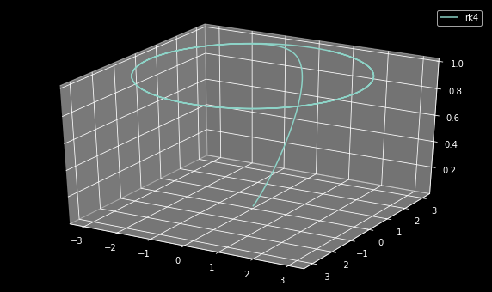
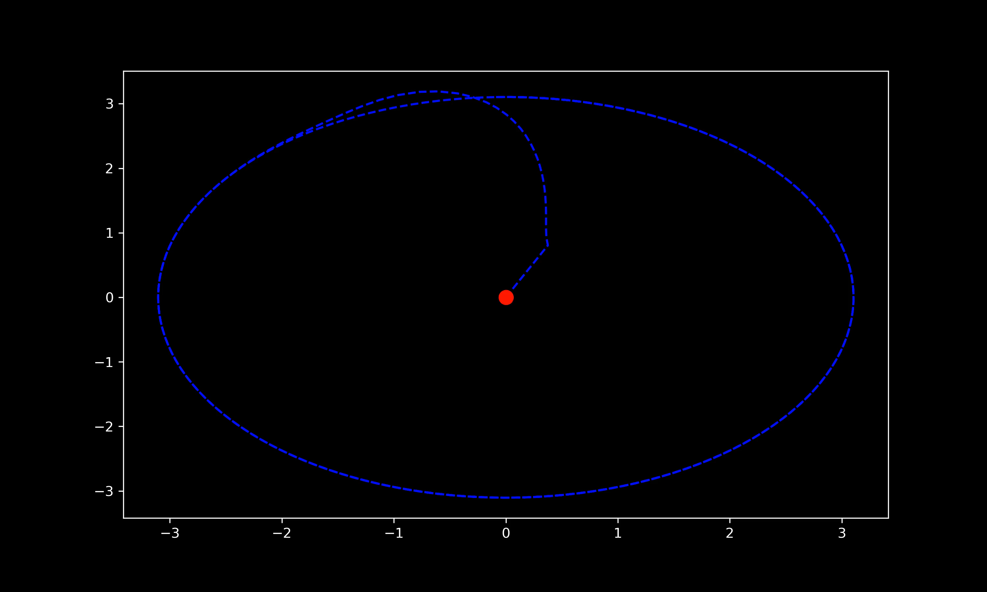
Simulation

Slide 9
Future Extensions: Using Differential Flatness
Differentially Flat - Differential flatness is a property of some nonlinear control system that allows the state vector and the input vector to be written in terms of a smaller number of so-called flat outputs and some number of time derivatives of those outputs
Endogenous transformation - the function that maps from the outputs and their time derivatives to the states and inputs is known as the endogenous transformation
Using the endogenous transformation would get states and inputs for the quadrotor to be used as a control reference to control it along the desired vector field
State ξ = [x, y, z, vx, vy, vz, ψ, θ, φ, p, q, r] T
Input µ = [fz, τx, τy, τz] T
Process: Get Vector field → spatial derivatives of vector field → time derivatives → states and inputs of the quadrotor using the endogenous transformation and differential flatness property
Zhou et al. 2014 - Vector Field Following using Differential Flatness
Notes:
Get Vector field → spatial derivatives of vector field → time derivatives → states and inputs of the quadrotor using the endogenous transformation and thm 1
I did not understand their endogenous transformation function from this paper that would enable me to do this.

Slide 10
References
Papers:
D. Zhou and M. Schwager, "Vector field following for quadrotors using differential flatness," 2014 IEEE International Conference on Robotics and Automation (ICRA), Hong Kong, China, 2014, pp. 6567-6572, doi: 10.1109/ICRA.2014.6907828
Ramasamy, Suresh & Wu, Guofan & Sreenath, Koushil. (2014). Dynamically Feasible Motion Planning through Partial Differential Flatness.. 10.15607/RSS.2014.X.053.
V. M. Goncalves, L. C. A. Pimenta, C. A. Maia, B. C. O. Dutra and G. A. S. Pereira, "Vector Fields for Robot Navigation Along Time-Varying Curves in n -Dimensions," in IEEE Transactions on Robotics, vol. 26, no. 4, pp. 647-659, Aug. 2010, doi: 10.1109/TRO.2010.2053077.
Other sources:
https://www.codeproject.com/articles/18922/solving-a-differential-equation
https://www.youtube.com/watch?v=0U3J_Ug075k
https://www.sciencedirect.com/topics/engineering/limit-cycle
https://link.springer.com/referenceworkentry/10.1007%2F978-1-4419-9863-7_533
https://softwareengineering.stackexchange.com/questions/164175/algorithm-to-calculate-trajectories-from-vector-field
https://www.youtube.com/watch?v=PdpHbdTmJ2A
http://underactuated.mit.edu/simple_legs.html
https://www.youtube.com/watch?v=T0-zFIPWONU
Github: https://github.com/rdensamo/CSE498-FinalProject-21-Densamo

